Slide 1


Digital Twin Technology in the Automotive Industry
Akhila Vulluri
Company confidential
Notes:
Hello everyone good morning, my name is Akhila Vulluri, and today I’ll be walking you through the exciting world of digital twin technology in the automotive sector. This is a concept that’s transforming how vehicles are designed, tested, manufactured, and even maintained. Let's explore what it means, how it works, and why it's important for the future of mobility.

Slide 2

Content:
Introduction
Key Components
Types of Digital Twins in Automotive
Applications
Enabling Technologies
Industry Examples
Benefits
Challenges
Future Outlook
Conclusion
Notes:
Here’s a quick look at what we’ll cover today. We’ll start with a basic introduction to digital twins, then dive into their key components and types. We’ll explore how they’re applied in the automotive world, the technologies that enable them, real-world examples, and of course, the benefits and challenges. Finally, we’ll wrap up with the future outlook and a summary.

Slide 3
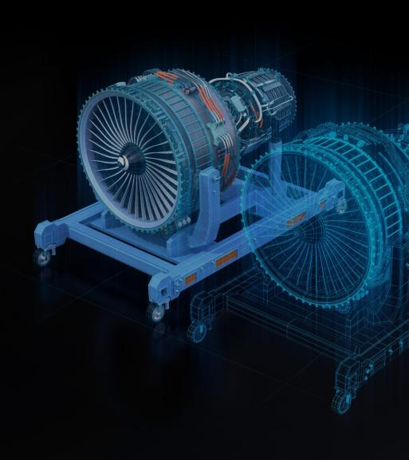
1.Introduction
What is a digital twin?
A digital twin is a virtual representation of an object or system designed to reflect a physical object accurately. It spans the object's lifecycle, is updated from real-time data and uses simulation, machine learning and reasoning to help make decisions.
Notes:
So what exactly is a digital twin? Simply put, it’s a digital version of a physical object—like a vehicle or its parts—that helps us simulate, monitor, and optimize its performance. It continuously updates using real-time data from sensors, and with the help of AI, it can predict failures, improve design, and enhance overall efficiency

Slide 4
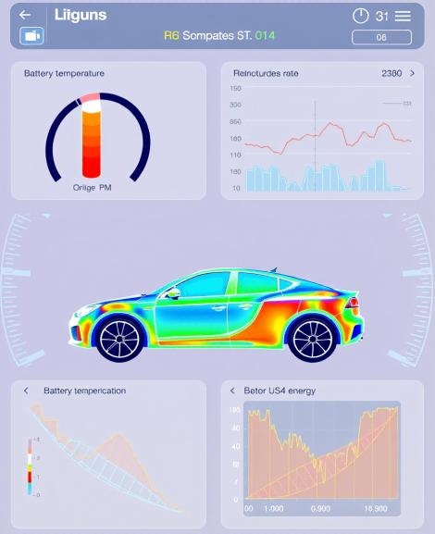
How does a digital twin work?
The studied object—for example, an electric vehicle (EV) powertrain—is outfitted with various sensors at key functional areas. These sensors produce data about critical performance aspects, such as:
Battery temperature and charge/discharge rates
Motor torque and RPM
Energy consumption
Driving behavior and ambient conditions
This real-time data is transmitted to a processing system, where it is applied to the digital replica of the powertrain.
Once updated with the relevant data, the digital twin can be used to:
Run simulations under various load or environmental conditions
Analyze anomalies such as unexpected battery drain or overheating
Test and validate potential improvements, like a new cooling strategy or energy management algorithm
The ultimate goal is to gain insights that help optimize performance, prevent failures, and enhance the efficiency and reliability of the actual vehicle powertrain.
Notes:
"Let’s break down how it functions. Think of a vehicle loaded with sensors collecting live data—temperature, torque, battery charge, even how a person drives. This data is sent to a digital platform, where a virtual copy of that vehicle simulates how it behaves under different conditions. This lets engineers run tests, predict failures, and make improvements without touching the real vehicle.

Slide 5
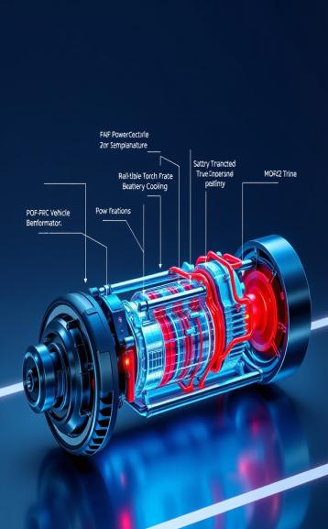
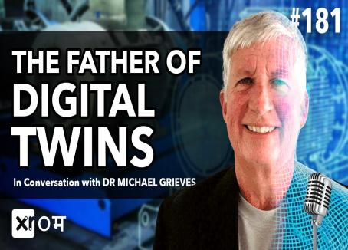
History of digital twin technology
The idea of digital twin technology was first voiced in 1991, with the publication of Mirror Worlds, by David Gelernter. However, Dr. Michael Grieves (then on faculty at the University of Michigan) is credited with first applying the concept of digital twins to manufacturing in 2002 and formally announcing the digital twin software concept. Eventually, NASA’s John Vickers introduced a new term, “digital twin” in 2010.
Notes:
"The term 'digital twin' might sound new, but the concept dates back to the 1990s. It gained traction in aerospace and later in manufacturing. NASA used digital twin concepts for space missions. In the 2000s, it was formalized, and now, industries like automotive are fully embracing it as a tool for smarter operations and predictive insight

Slide 6
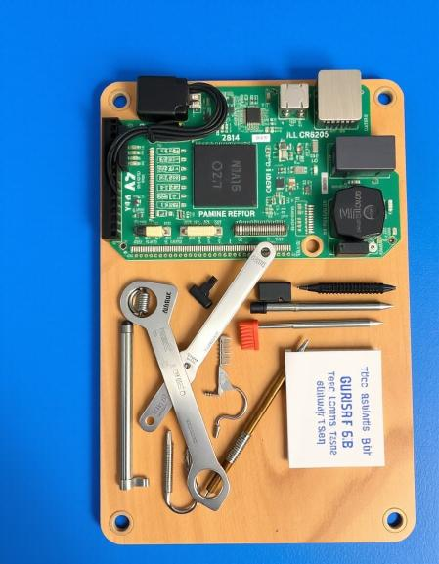

2. Key Components
Physical Entity
Digital Model
Data Sensors and IoT Devices
Data Integration and Communication Layer
Analytics and AI/ML Models
Visualization Tools
Feedback Mechanism
Security and Privacy Layer
Company confidential
Notes:
Every digital twin system is built from a few critical components: the real-world object, its virtual counterpart, and the data that connects them. But there’s more to it—like how data is transmitted, how insights are generated, and how visualizations and feedback loops work together. Let’s break down each part.

Slide 7
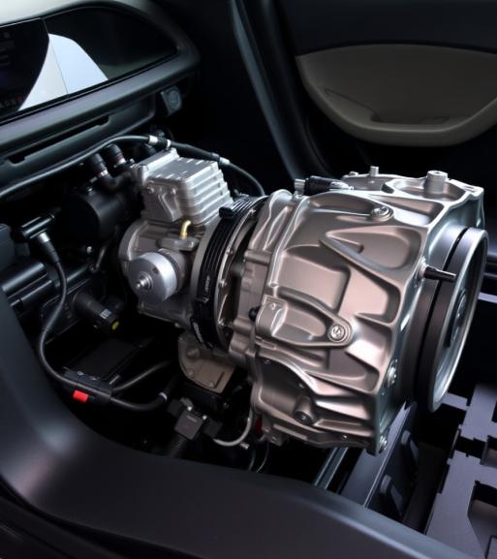
1. Physical Entity
The actual vehicle, subsystem, or component that the digital twin represents.
Automotive Example: A hybrid electric vehicle, a transmission unit, or an ADAS (Advanced Driver Assistance System).
Use Case: Monitoring how a physical powertrain behaves during real-world driving scenarios like city traffic vs. highway cruising.
Notes:
"This is the real product—like a car, a battery, or a braking system. The digital twin mirrors this physical object. In automotive a battery, or a braking system of a car that we want to monitor for comfort and performance."

Slide 8
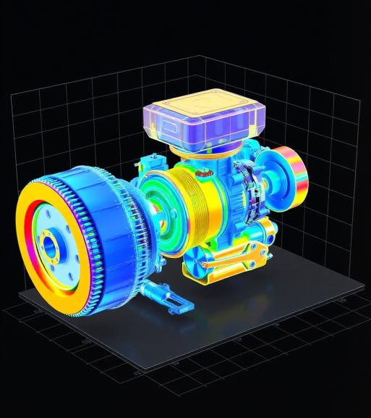
2. Digital Model
A virtual clone of the physical entity built using:
3D CAD (computer aided design) models
Control logic simulations (e.g., Simulink)
Physics-based models and real-world test data
Automotive Example: A digital model of an EV drivetrain with electrical and thermal characteristics.
Use Case: Simulating how the inverter responds to varying load conditions to avoid overheating.
Notes:
"The digital model is the virtual representation of that real object. Built using CAD tools and real-world data, this model can simulate behavior under different conditions. For example, it can tell us how a vehicle’s battery performs in extreme heat or how its drivetrain reacts to sudden acceleration."

Slide 9
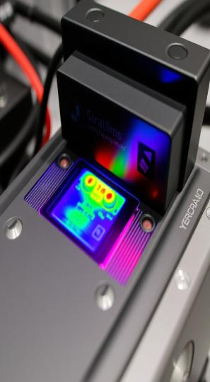
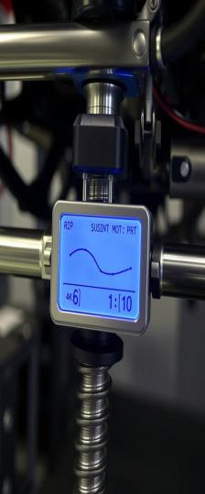
3. Data Sensors and IoT Devices
Sensors embedded in the vehicle capture live data across multiple domains:
Mechanical (e.g., pressure, torque)
Electrical (e.g., voltage, current)
Environmental (e.g., humidity, external temperature)
User behavior (e.g., braking style, steering angle)
Automotive Example:
Battery pack sensors monitoring thermal hotspots
Accelerometers on suspension systems for ride quality analysis
Use Case: Collecting real-time tire pressure data to optimize fuel economy and safety.
Notes:
"Data is the lifeline of a digital twin. Sensors in the vehicle collect mechanical, electrical, and even user behavior data. These inputs give the twin its ‘awareness’ of how the physical system is performing, letting it react and adapt in real time."

Slide 10
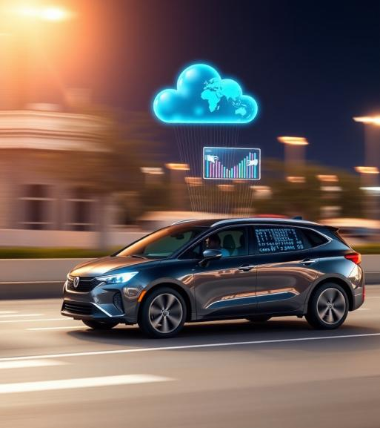
4. Data Integration and Communication Layer
This ensures secure and efficient transmission of sensor data from the vehicle to the digital twin, often using:
CAN bus
Telematics units
IoT protocols like MQTT/CoAP
Edge computing and cloud-based platforms
Automotive Example: A modern passenger vehicle transmitting real-time ADAS sensor data (like camera and radar feeds) to a cloud-based digital twin for remote diagnostics and software optimization.
Use Case: Enhancing the accuracy of lane-keeping and collision avoidance systems based on real-world driving data.
Notes:
"Once we have sensor data, we need a secure and reliable way to send it to the digital twin. This is where protocols like CAN bus, cloud platforms, and IoT frameworks come in. This layer ensures that what happens in the real world is instantly reflected in the virtual model."

Slide 11
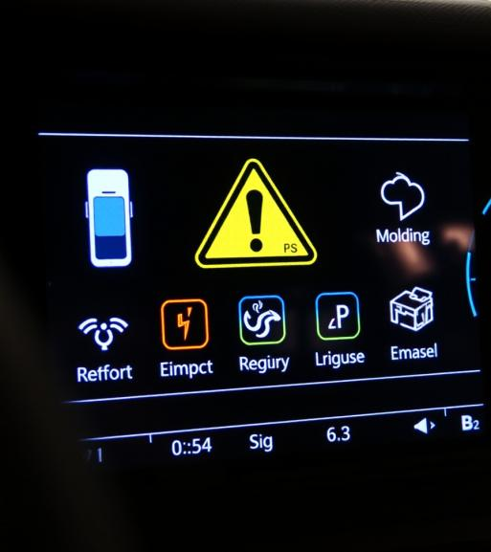
5. Analytics and AI/ML Models
Advanced data analytics platforms and machine learning algorithms analyze historical and real-time data to:
Predict component failures
Recommend maintenance actions
Optimize energy and thermal management strategies
Automotive Example: Machine learning models can spot early warning signs of motor wear or unusual behavior in driver-assist systems, helping catch issues before they become serious problems..
Use Case: Predictive maintenance for EV battery modules to reduce warranty costs and increase uptime.
Notes:
"This is where the magic really happens. The real-time and historical data collected is analyzed using AI and machine learning algorithms. These tools can detect patterns, predict failures, and even suggest optimizations. For example, they might recognize a decline in motor performance long before it becomes a problem."

Slide 12
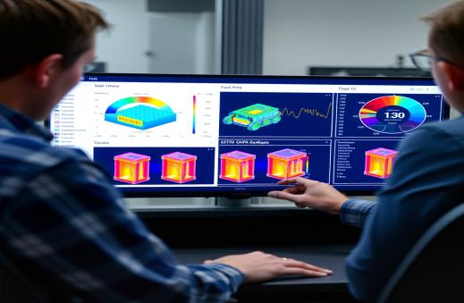
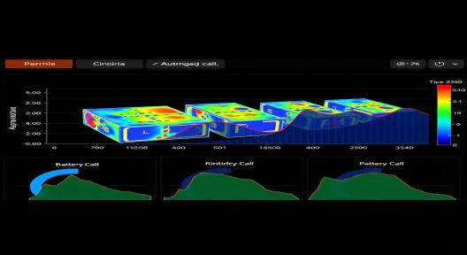
6. Visualization Tools
These provide an interactive UI or dashboard to:
Monitor the digital twin
Run real-time simulations
Visualize alerts and KPIs
View historical trends
Automotive Example: OEM engineers using a 3D dashboard to visualize thermal behavior of battery cells under different drive cycles.
Use Case: Service centers accessing a digital twin to diagnose vehicle issues remotely before a customer even visits.
Notes:
"All the data and analysis need to be presented in a way that engineers and managers can understand and act on. Visualization tools do exactly that—through dashboards, 3D models, and performance charts. These tools help us simulate scenarios, view alerts, and make quick decisions based on clear insights."

Slide 13

7. Feedback Mechanism
Allows the digital twin to send recommendations or control inputs back to the physical system for:
Automated performance tuning
Remote software updates (OTA)
Maintenance scheduling
Automotive Example: Sending a cooling control signal to prevent battery overheating based on simulated scenarios.
Use Case: Real-time suspension adjustments in a connected car for dynamic road conditions.
Notes:
"A digital twin isn’t just passive—it can act. This feedback mechanism allows the twin to send control commands back to the physical system. For example, if the simulation detects overheating, the system can trigger cooling in real-time. This kind of closed-loop control makes systems smarter and more efficient."

Slide 14
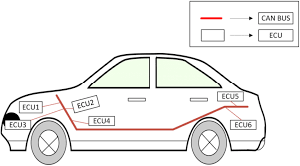
8. Security and Privacy Layer
Protects the integrity, confidentiality, and availability of the data. Key features include:
End-to-end encryption
Role-based access control
Compliance with industry standards
Automotive Example:
Encrypting OTA updates for ECUs
Preventing cyberattacks on connected
vehicles
Standards Followed:
ISO/SAE 21434 for cybersecurity
GDPR/CCPA for user data protection
Notes:
"With all this real-time data exchange, security is critical. This layer ensures encryption, access control, and compliance with standards like GDPR or ISO 21434. It’s especially important in automotive, where connected systems and user data need to be protected against cyber threats."

Slide 15

Types of digital twins
Company confidential
Notes:
"Digital twins can come in different forms, depending on what they represent. It could be a single component, a system, an entire process, or even a whole organization. Let’s go through each type to see how they're used in the automotive industry."

Slide 16
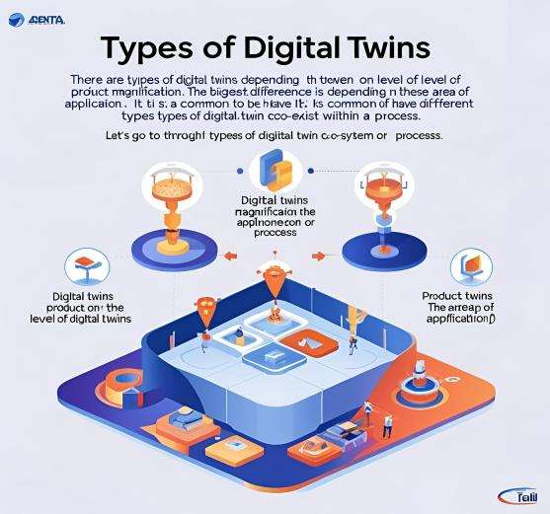
Types of digital twins
There are various types of digital twins depending on the level of product magnification. The biggest difference between these twins is the area of application. It is common to have different types of digital twins co-exist within a system or process. Let’s go through the types of digital twins to learn the differences and how they are applied.
Notes:
"Sometimes multiple types of digital twins exist in one system. For example, an electric vehicle might have a digital twin for its battery, its motor, and for the entire vehicle. Each type serves a different purpose, from part-level monitoring to high-level performance analysis."

Slide 17
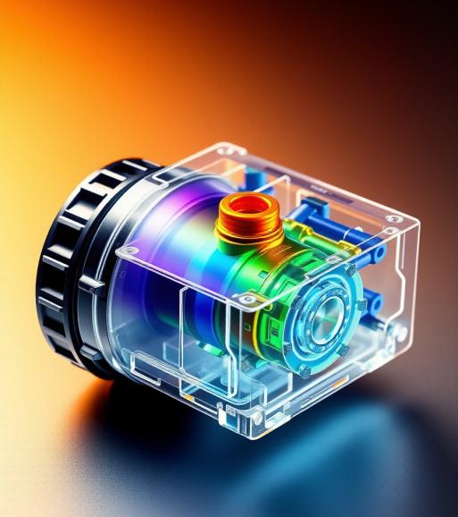
1.Component or Part Twin
Definition: Digital representation of a single automotive part.
Example: A digital twin of a fuel injector, brake pad, or battery cell in an electric vehicle.
Use Case:
Predictive maintenance (e.g., forecasting wear on brake pads).
Performance monitoring (e.g., injector spray pattern analysis).
Notes:
"This twin focuses on a specific part—like a brake pad or fuel injector. It’s useful for monitoring wear and tear and predicting when a part needs maintenance or replacement. It’s a small-scale model with a big impact on reliability and safety."

Slide 18
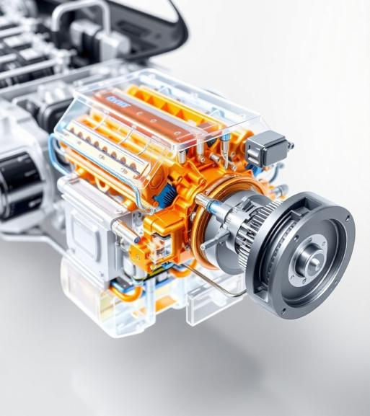
2. Asset Twin
Definition: Represents an entire automotive subsystem made up of multiple components.
Example: A digital twin of a car engine, transmission system, or electric motor assembly.
Use Case:
Lifecycle monitoring (e.g., engine health over time).
Subsystem performance optimization (e.g., improving combustion efficiency).
Notes:
"An asset twin is a bit bigger—it represents a subsystem like a transmission or an electric motor. It helps track the health and performance of the system over time and can provide insights that lead to efficiency improvements or cost savings."

Slide 19
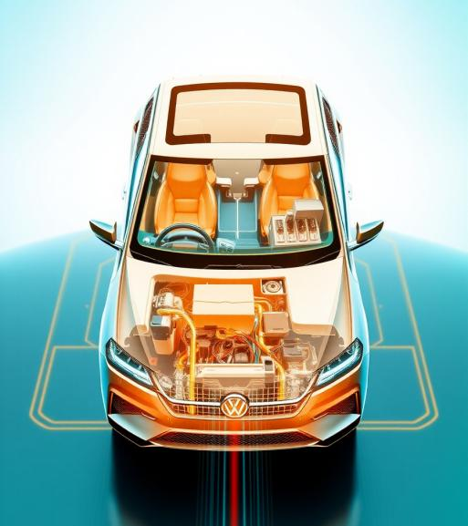
3. System or Unit Twin
Definition: Represents an integrated system in the vehicle, combining several assets.
Example: A digital twin of the vehicle drivetrain, ADAS (Advanced Driver Assistance System), or infotainment system.
Use Case:
System-level diagnostics (e.g., fault detection in ADAS).
Optimization of vehicle performance (e.g., tuning power delivery across drivetrain).
Notes:
"This one captures the behavior of a full system, such as the drivetrain or ADAS (Advanced Driver Assistance System). It enables system-level diagnostics and performance tuning, helping engineers make the entire vehicle smarter and safer."

Slide 20
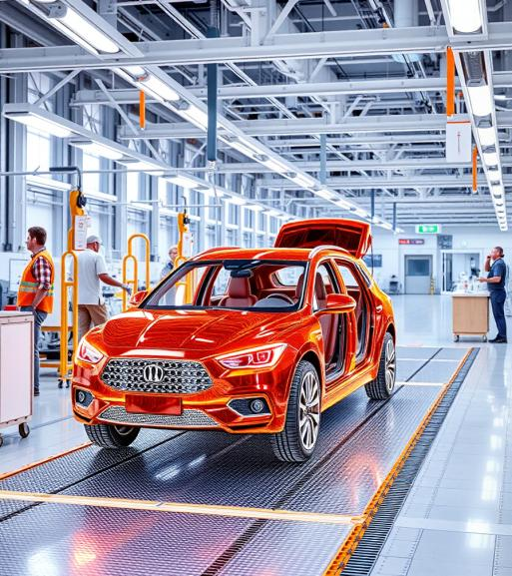
4. Process Twin
Definition: Digital representation of a vehicle manufacturing or assembly process.
Example: A digital twin of the final vehicle assembly line, paint shop, or battery pack production process.
Use Case:
Process simulation to improve cycle time.
Bottleneck analysis to enhance throughput and reduce downtime.
Notes:
"A process twin focuses not on the vehicle but on how it’s built. It simulates the manufacturing process—like an assembly line or a paint shop. It helps identify bottlenecks, reduce cycle time, and improve the overall production efficiency."

Slide 21
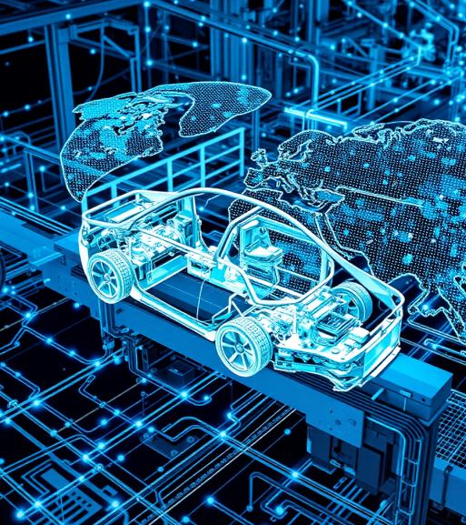
5. Organization or Network Twin
Definition: Represents an automotive enterprise ecosystem, like plants, suppliers, and distribution channels.
Example: A digital twin of a global automotive supply chain, or a network of smart manufacturing plants.
Use Case:
Strategic decision-making (e.g., optimizing logistics or responding to supply chain disruptions).
Production planning and resource allocation across multiple plants.
Notes:
"This is the broadest type of digital twin—it represents an entire network, such as a supply chain or a global production system. It helps companies make big-picture decisions, like optimizing logistics across plants or responding quickly in the supply chain."

Slide 22
4. Applications of Digital Twin in the Automotive Industry
Company confidential
Notes:
"Now let’s look at how digital twins are applied in real automotive indudtry. From vehicle design to predictive maintenance, these applications are revolutionizing how OEMs operate. The value isn’t just technical—it’s strategic, enhancing quality, efficiency

Slide 23
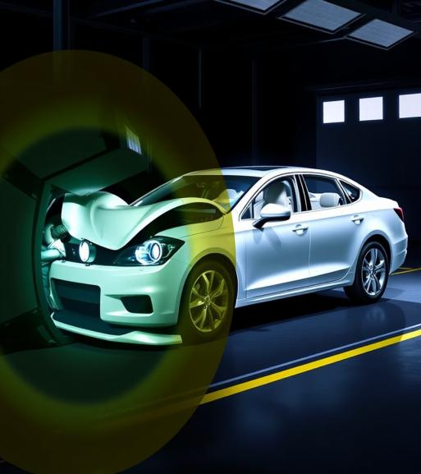
Vehicle Design & Development
Simulate aerodynamics, crash behaviour, and NVH (Noise, Vibration, Harshness)
Reduce physical prototyping time and cost
Example: Virtual crash tests for bumper design validation
Notes:
"In product development, digital twins allow engineers to virtually test new designs before ever building a prototype. They can simulate different materials, structures, or configurations to optimize for performance, safety, and cost—saving months of trial and error."

Slide 24
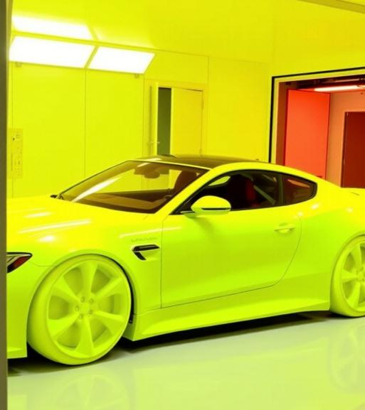
Manufacturing Optimization
Digital twins of production lines to analyze workflow and reduce downtime
Identify bottlenecks and simulate improvements
Example: Simulating car paint booths for better coating efficiency
Notes:
"In the factory, digital twins simulate production lines, helping improve layout and workflow. They can identify inefficiencies, test new configurations, and even predict machine failures—leading to higher productivity and less downtime."

Slide 25
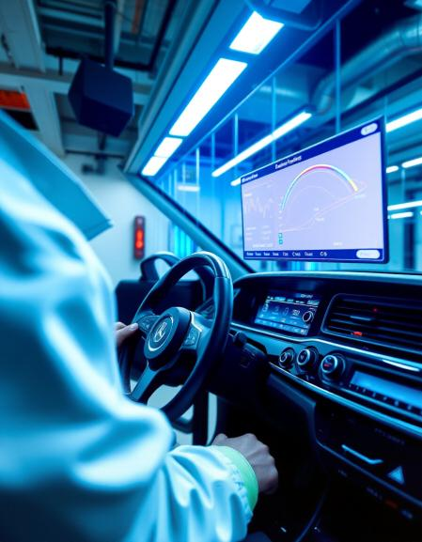
Testing and Calibration
Integrate with HiL and SiL systems for early-stage validation
Test control systems, fuel efficiency, and emissions in a virtual environment
Example: ECU calibration using digital twin for BS6 compliance
Notes:
"Instead of relying only on physical testing, digital twins allow us to virtually test and calibrate vehicle systems. This includes things like suspension tuning, brake response, and power delivery—under various simulated environments and driving conditions."

Slide 26
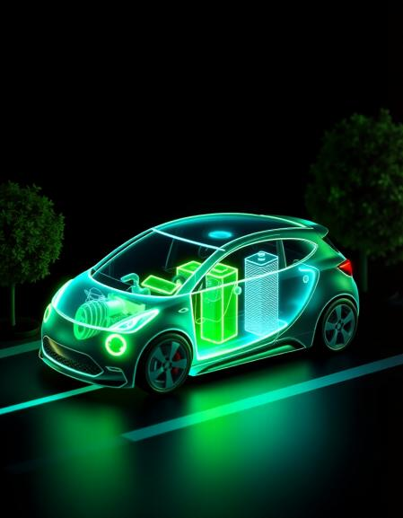
Predictive Maintenance
Monitor real-time health of components
Predict failures and schedule proactive maintenance
Example: Forecasting battery degradation in electric vehicles
Notes:
"One of the most practical applications—predictive maintenance—lets us foresee when a component is about to fail. Instead of fixing things after they break, digital twins help schedule maintenance in advance, reducing breakdowns and repair costs."

Slide 27

5.Enabling Technologies
Company confidential
Notes:
Nothing to explain

Slide 28


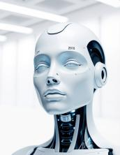
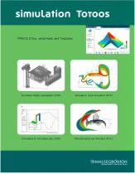

Enabling Technologies
🧠 AI & ML: Predict failures and optimize vehicle systems
🌐 IoT Sensors: Capture live data like speed, pressure, etc.
☁️ Cloud & Edge Computing: Enable fast data processing and feedback
🧪 Simulation Tools: Run digital tests for virtual validation
📡 5G Connectivity: Ensure real-time data flow and OTA updates
Notes:
"Now let’s talk about the technologies that make digital twins possible—things like cloud computing, AI, IoT sensors, and edge computing. These are the building blocks that allow us to gather, transmit, process, and act on data in real time."

Slide 29
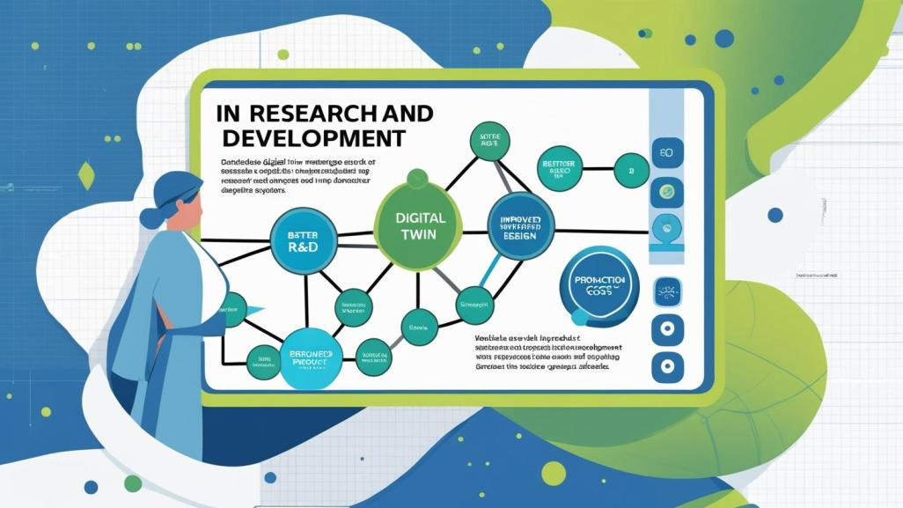
Advantages and benefits of digital twins
Better R&D
The use of digital twins enables more effective research and design of products, with an abundance of data created about likely performance outcomes. That information can lead to insights that help companies make needed product refinements before starting production
Notes:
"This slide highlights one of the biggest values digital twins bring to the table: better research and development. Since the digital model captures real-world data and simulates performance virtually, engineers can test and refine products before anything is physically built. This leads to faster design cycles, physical prototypes, and more confidence in the product’s performance before launch. It ultimately reduces cost and risk in the development process."

Slide 30
6. Industry Examples
Notes:
"Let’s now look at how real companies are using digital twin technology in the automotive world.

Slide 31
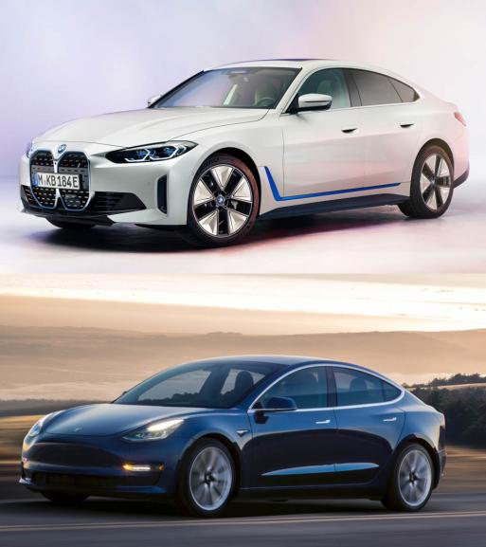
Tesla & BMW
Tesla – Performance Optimization & OTA Updates
Digital twin created for every car, mirroring real-time data.
Monitors motor, battery, and software health.
Enables Over-the-Air (OTA) updates to fix bugs and enhance features.
Boosts predictive diagnostics and customer experience.
BMW – Smart Factory Planning
Uses digital twins to simulate production lines and machines.
Optimizes layout, logistics, and process workflows.
Enables early error detection and virtual commissioning.
Reduces manufacturing costs and increases agility.
Notes:
"Let’s start with Tesla. Every Tesla car has its own digital twin, which receives live updates and feedback from the physical car. This allows them to send over-the-air updates, fix bugs remotely, and improve performance—all without the car visiting a service center. Now, BMW uses digital twins in their smart factories. They simulate entire production lines, test them virtually, and identify issues before they happen—this reduces downtime, enhances quality, and cuts operational costs."

Slide 32
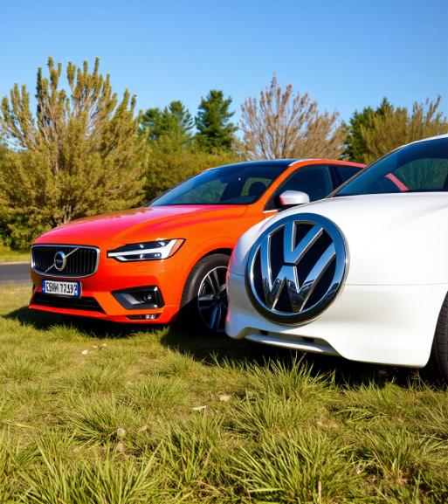
Volkswagen & Volvo
Volkswagen – Predictive Maintenance
Cloud-based digital twins monitor component health (e.g., engine, brakes).
AI analyzes wear and predicts maintenance needs.
Minimizes unexpected breakdowns, improves safety.
Volvo – Autonomous Driving Simulation
Simulated environments for testing ADAS and AV software.
Digital twins help train AI for decision-making and safety.
Cuts down physical testing and speeds up R&D.
Notes:
"Volkswagen and Volvo, uses digital twins mainly for predictive maintenance. Their vehicles send real-time data to the cloud, and machine learning models analyze that data to predict when parts might fail. This means surprise breakdowns.

Slide 33
7. Benefits of Digital Twin in Automotive
Notes:
"Now let’s focus on the overall benefits of digital twins in automotive.

Slide 34
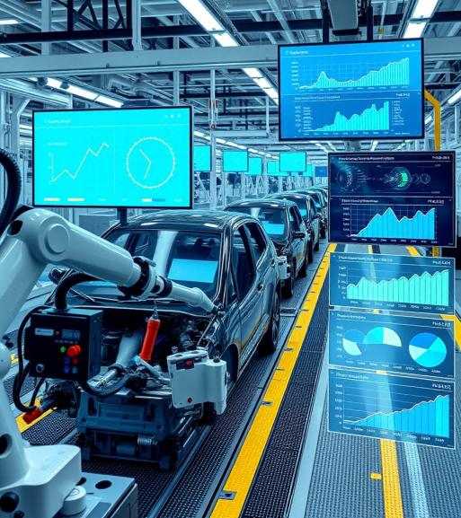
Benefits of Digital Twin in Automotive
✅ Reduced Development Time & Costs
Virtual testing and simulation cut down on physical prototypes.
Faster iterations and early error detection lower R&D expenses.
✅ Enhanced Safety & Reliability
Real-time monitoring and predictive analytics prevent failures.
Improves system robustness and reduces recalls.
✅ Optimized Manufacturing Efficiency
Digital twins streamline factory planning and operations.
Boosts productivity and reduces downtime.
✅ Improved Customer Satisfaction & Service
Predictive maintenance enhances vehicle uptime.
OTA updates and personalization improve the user experience.
Notes:
"First, we have faster development and lower costs—thanks to simulation and prototypes. Second, we gain better safety and reliability from real-time diagnostics and predictive analytics. Third, they help optimize manufacturing by reducing downtime and improving workflows. And finally, the customer experience improves with features like predictive service alerts and OTA updates, keeping vehicles safer and more personalized."

Slide 35
8.Challenges of Implementing Digital Twin in Automotive
Notes:
"Of course, it’s not all easy. Like any advanced technology, digital twins come with challenges 2.

Slide 36

Challenges of Implementing Digital Twin in Automotive
⚠️ High Complexity in Integration
Requires seamless coordination between hardware, software, and data systems.
Integration across the vehicle lifecycle can be technically demanding.
⚠️ Data Privacy & Cybersecurity Risks
Real-time data exchange increases exposure to cyber threats.
Protecting vehicle and user data is a critical concern.
⚠️ Large Upfront Investment
High costs for digital infrastructure, simulation tools, and cloud platforms.
ROI may take time, especially for smaller manufacturers.
⚠️ Skilled Workforce Requirement
Need for experts in AI, simulation, data science, and systems engineering.
Upskilling and hiring are necessary for successful deployment.
Notes:
"First, integration is tough—it requires syncing hardware, software, and data systems across a vehicle’s lifecycle. Next, there are cybersecurity concerns, as real-time data can be a target for hackers. Third, the initial investment in infrastructure, software, and cloud platforms is significant. And finally, you need a highly skilled workforce—people who understand AI, simulation, automotive systems, and data science."

Slide 37
9.Future Outlook of Digital Twin in Automotive
Notes:
"Looking ahead, digital twins will be a foundation for next-gen vehicles.

Slide 38
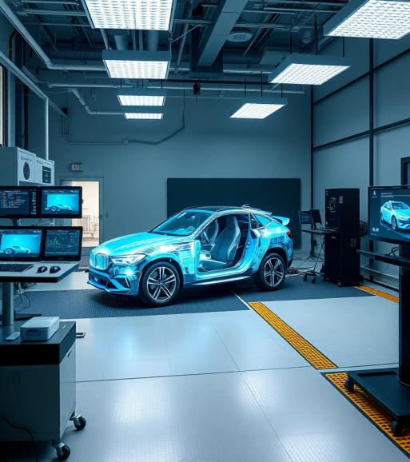
Future Outlook of Digital Twin in Automotive
🔮 Foundation for the Future of Mobility
Digital twins will be central to the evolution of Autonomous, Connected, and Electric Vehicles (ACEV).
🤖 Integration with AI & Edge Computing
Real-time analytics powered by AI and edge computing will make vehicles smarter and more responsive.
Enables instant decision-making in autonomous driving and predictive maintenance.
🌐 Smarter, Safer, and Efficient Transportation
Enhanced simulation, testing, and monitoring will improve safety, sustainability, and customer personalization.
Supports continuous learning and over-the-air improvements throughout the vehicle lifecycle.
Notes:
"The future is exciting. With AI and edge computing, digital twins will be smarter and more responsive than ever. They’ll enable vehicles to self-monitor, self-diagnose, and even self-improve. This means more efficient mobility, fewer failures, and safer roads."

Slide 39
10.Conclusion and Summary
Notes:
"To wrap up, digital twin technology is truly transforming the automotive world. From design and testing to maintenance and customer service—it touches every part of the vehicle lifecycle. As this tech matures, it will continue driving smarter, safer, and more sustainable mobility solutions."

Slide 40
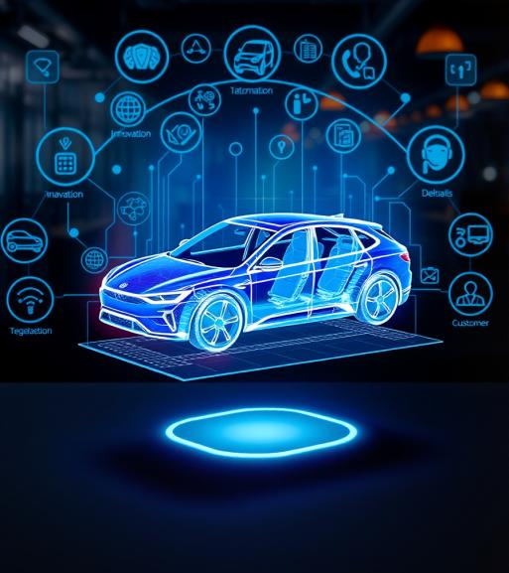
Conclusion and Summary
Digital Twin Technology is revolutionizing how vehicles are designed, tested, produced, and maintained.
Acts as a bridge between physical systems and digital intelligence, enabling data-driven decision-making across the vehicle lifecycle.
Empowers faster innovation, smarter manufacturing, and personalized customer experiences.
As the industry moves towards autonomous, connected, and electric vehicles, digital twins will become a core enabler of transformation.
Notes:
"This slide is a recap: Digital twins bridge the physical and digital world, empowering better decisions, faster innovation, and personalized experiences. As vehicles get more connected and autonomous, digital twins will be essential—not optional."

Slide 41



Thank You
Digital Twin Technology in the Automotive Industry -Akhila Vulluri
Notes:
"Thank you all for your time and attention. I hope this presentation gave you a clear understanding of how digital twin technology is shaping the future of the automotive industry.

